Slide 1
Module 1.5:
ML in Python
Python Env for Machine Learning
ML for Cybersecurity

Slide 2
Hardware and Software Preparation
You will need a laptop to get the most of the session, with Python (3.7 or higher) installed, along with numpy, scipy, sklearn, and in later modules, tensorflow.
You also need to have the Jupyter Notebook or JupyterLab installed

Slide 3
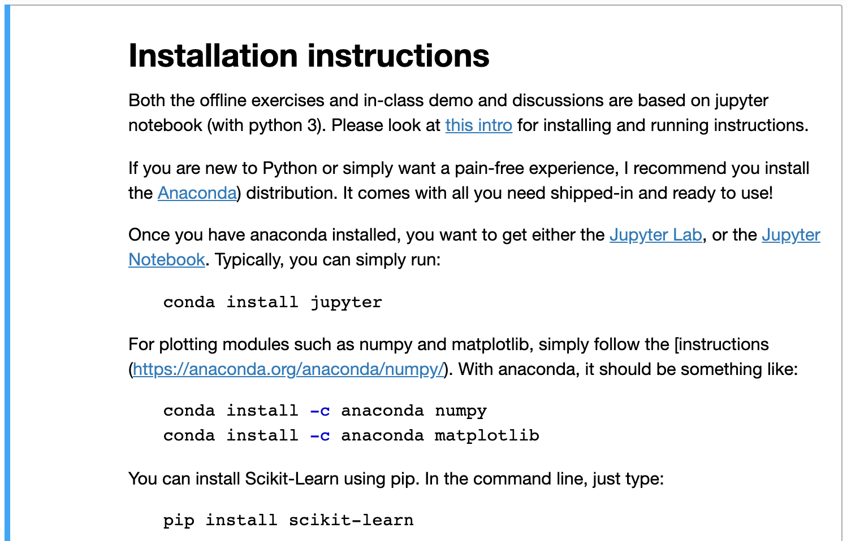

Slide 4
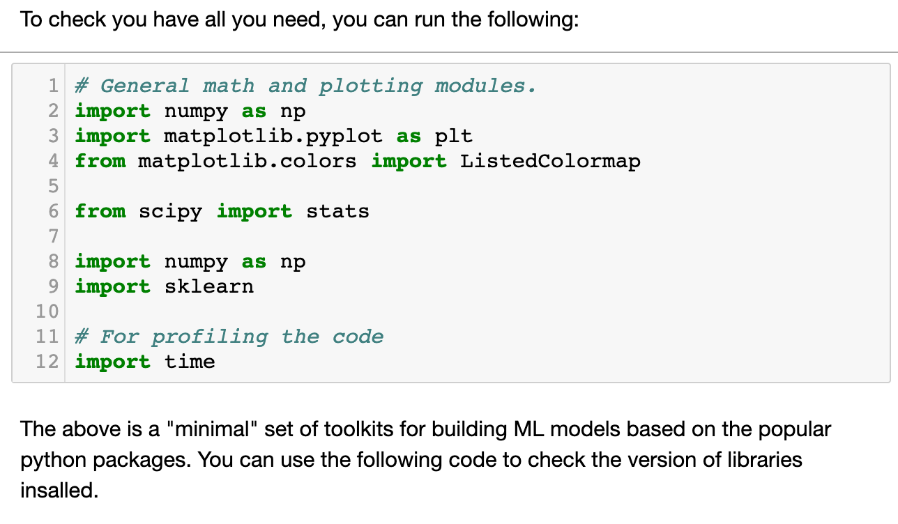
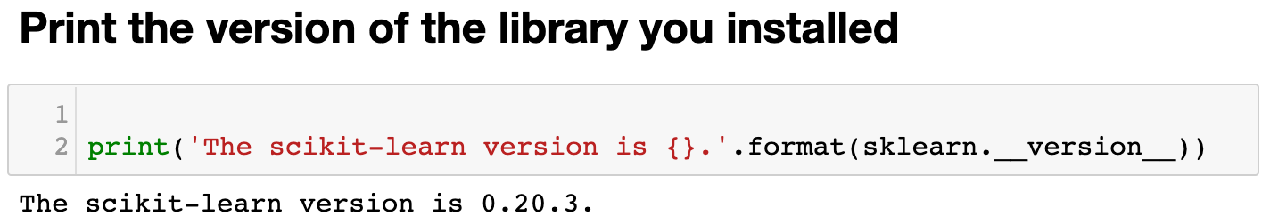

Slide 5
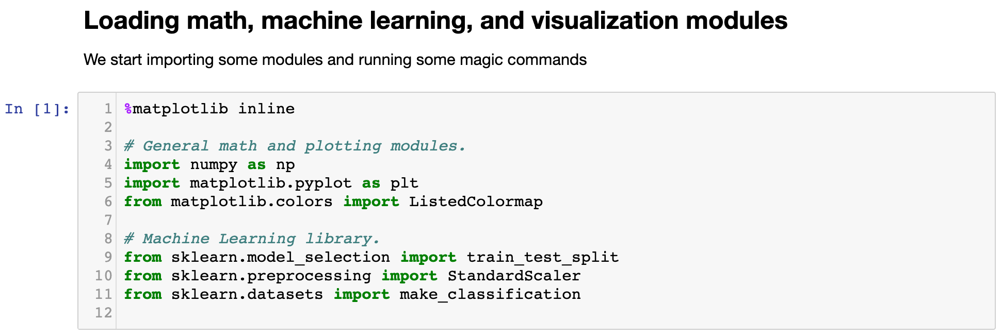
Demo of a Simple ML Pipeline: Load Libraries

Slide 6
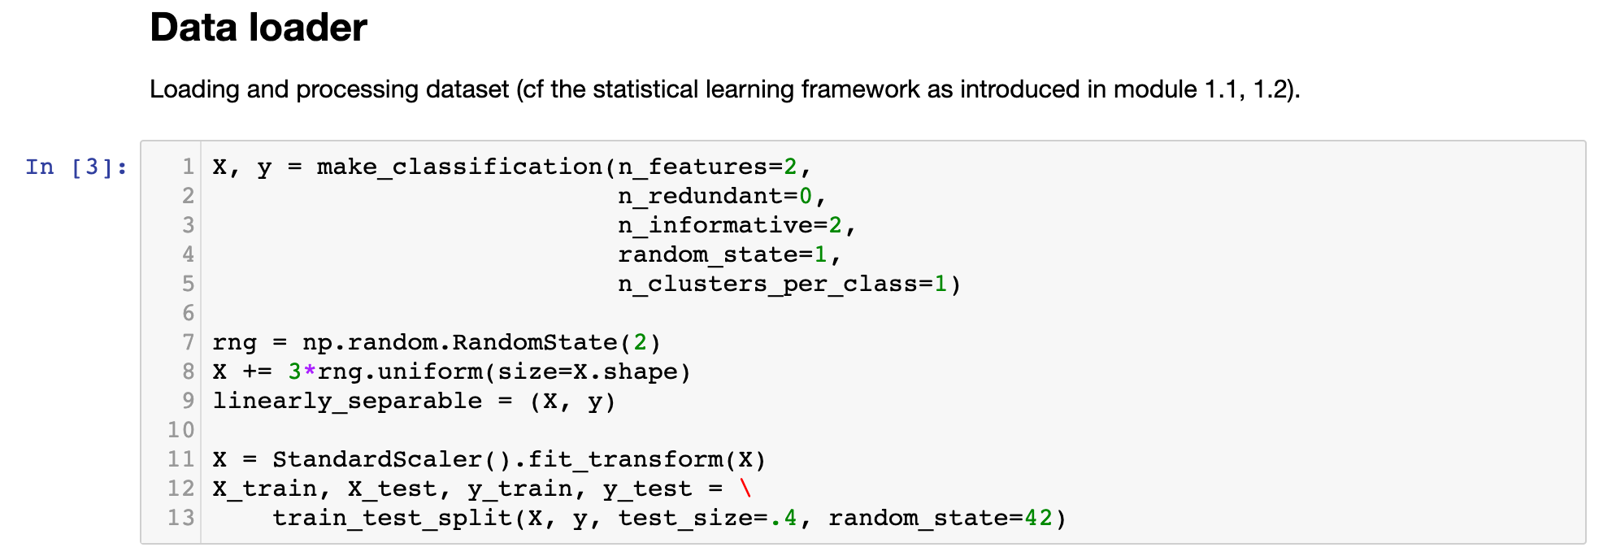
Demo of a Simple ML Pipeline: Loading Data

Slide 7
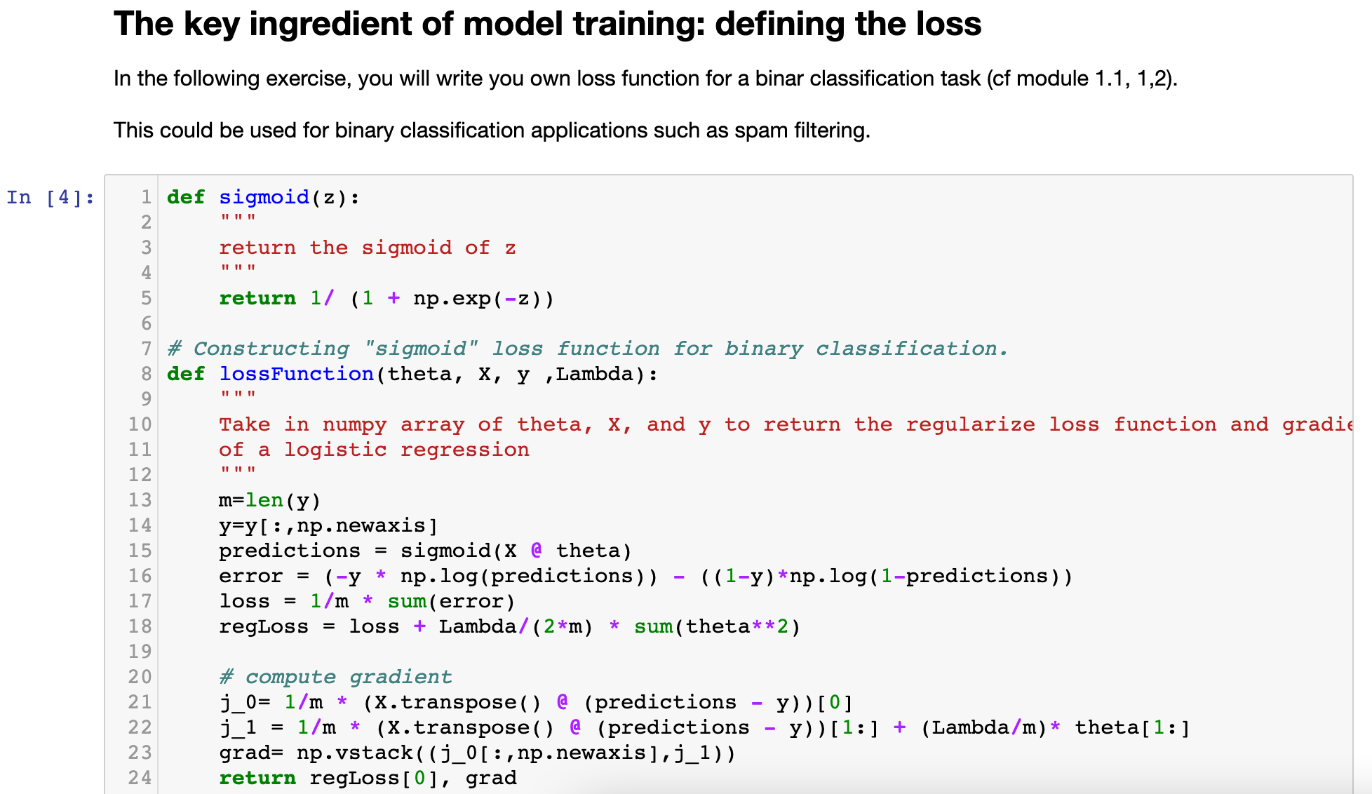

Slide 8
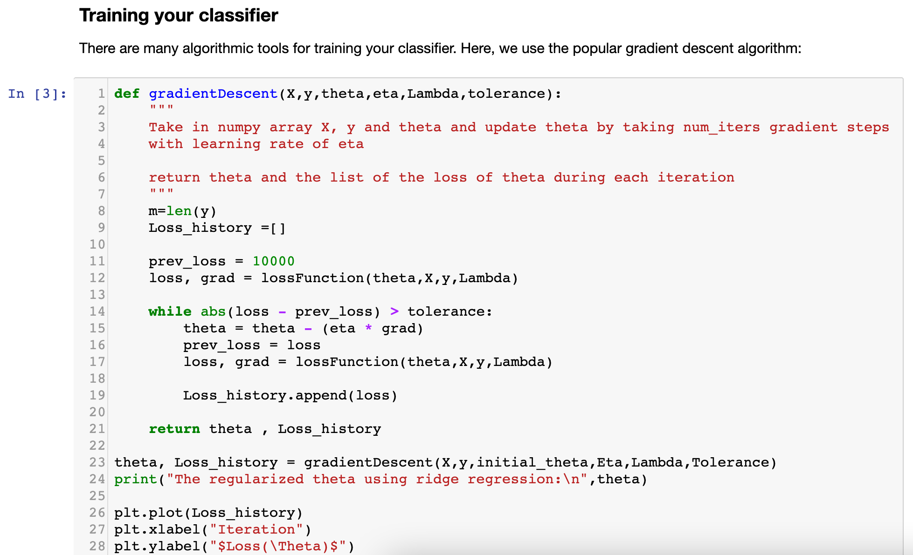
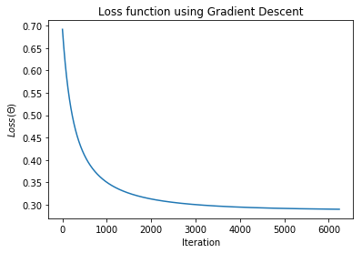

Slide 9
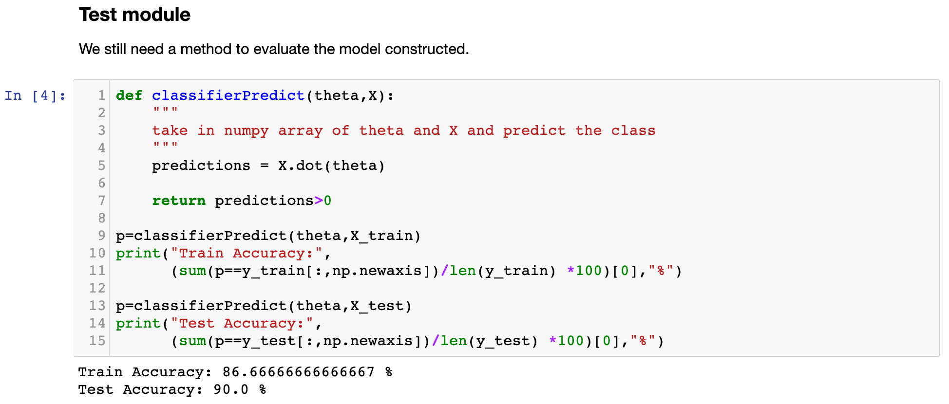

Slide 10
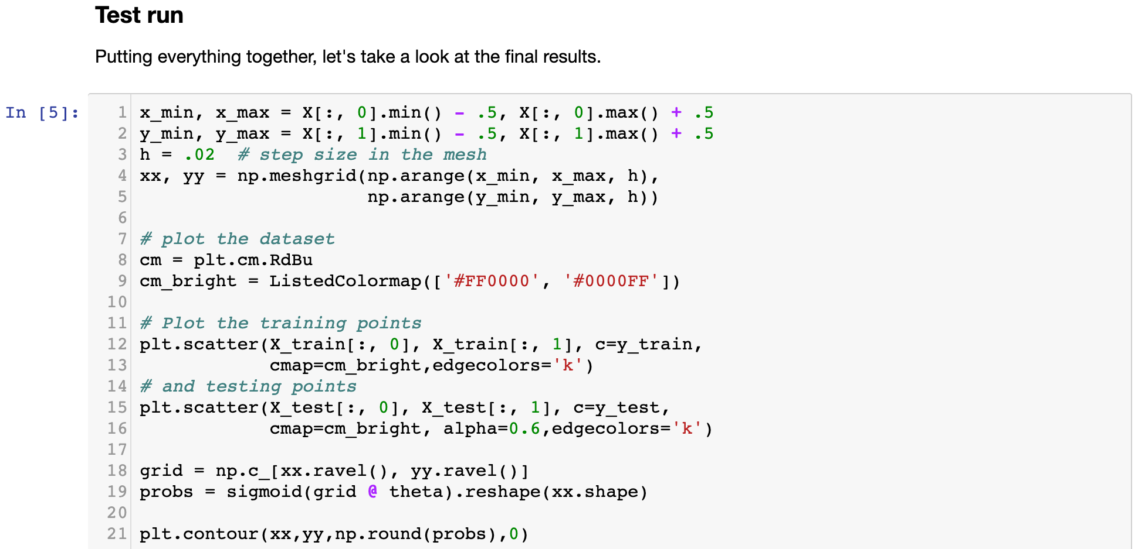
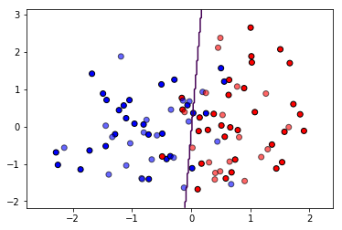
Demo of a Simple ML Pipeline: Try it out!

